Slide 1


Quantum Scheduling: The next frontier?
Analysis of Grover Search for scheduling
Insert Quantum Pun Here · Intermountain Quantum Competition 2026
Notes:
Introduce the team and the client. Set up the one question this talk answers: invest in quantum scheduling, or pass?

Slide 2



Meet Master Planner
Who they are
What they deliver
A scheduling outsourcer that builds staff schedules for businesses across many industries
Constructed schedules for clients within given parameters
Our sample for this briefing: staff scheduling at a care facility

Slide 3
What Master Planner has been hearing
“Quantum computers try every schedule in parallel”
“Grover search runs faster and cheaper”
“O(1) computation time”
“Get in early or fall behind”
Notes:
Paraphrased claims, not quotes from a specific source. Trigger: [a competitor’s “quantum-powered scheduling” announcement]. Our three questions: can it work, is it better, is it ready?

Slide 4
Quantum Overview
Notes:
Back to basics, show how unique aspects of quantum computing can yield results

Slide 5
Bits and qubits
Bit
Qubit
0
1
α|0⟩
β|1⟩
or
+
Always exactly one value
A superposition of both; measuring gives 0 or 1 with probabilities |α|² and |β|²
n qubits hold amplitudes for all 2ⁿ combinations at once: 8 qubits = 256 schedules
This scales exponentially - more qubits, more possibilities
Notes:
Bits. Qubits - probability + phase - not all at once! Measurement, bra-ket. Scalibility

Slide 6

Grover in four steps
01
02
03
04
Superposition
Oracle
Diffuser
Measure
Initializing all schedules equally likely
Flip the sign of every valid schedule
Flip every amplitude around the average
Read out a schedule and check it
Notes:
N = number of possible schedules, M = number of valid ones. Our 8-qubit case: N = 256, M = 3, best k = 7.

Slide 7
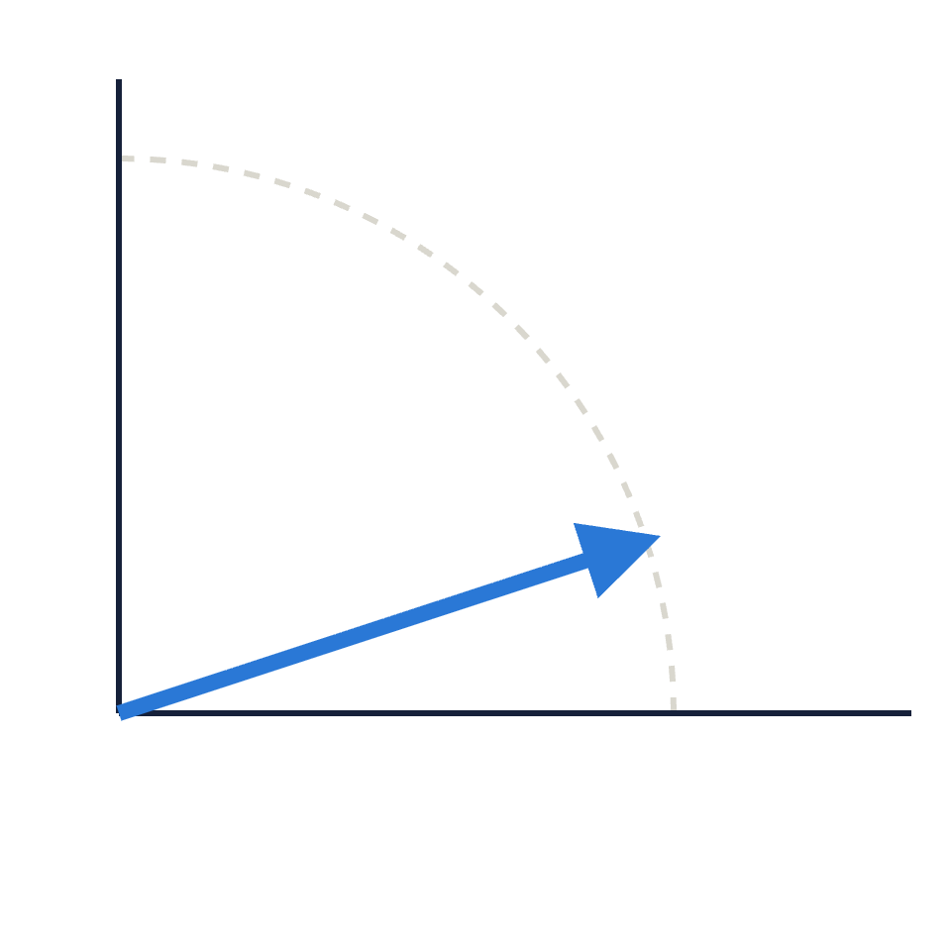
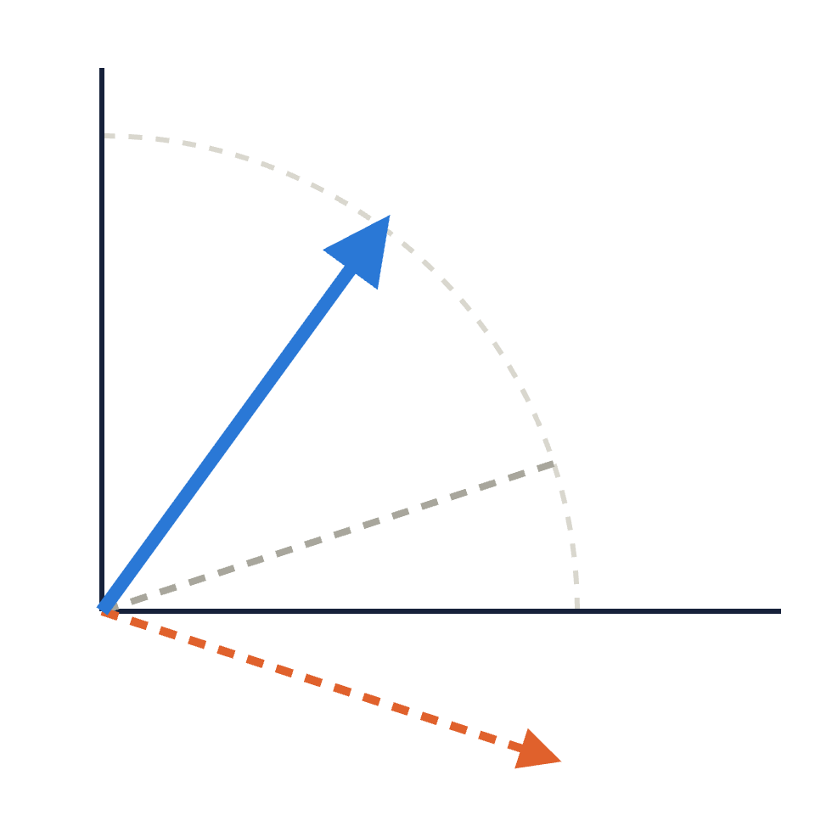
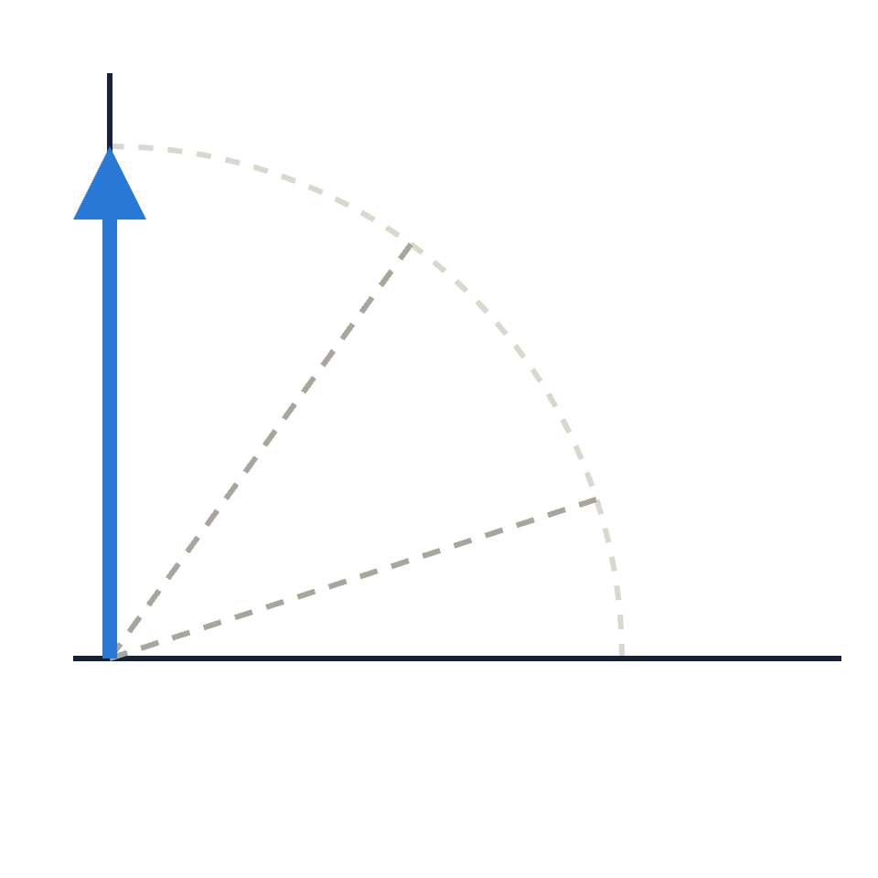
Each iteration rotates toward the valid schedules
Valid schedules
Valid schedules
Valid schedules
3θ
5θ
θ
Invalid
Invalid
Invalid
oracle flip
Start: almost all invalid
1 iteration: oracle flips, diffuser reflects: +2θ
~(π/4)√(N/M) iterations: on target. One more overshoots
Notes:
The state always lives in a 2-D plane spanned by “all valid schedules” and “all invalid schedules.” It starts at angle θ where sin²θ = M/N. Each iteration is two reflections: the oracle flips it below the invalid axis, the diffuser reflects it about the starting state, a net rotation of 2θ. Drawn with θ = 18° so it’s visible; in our 8-qubit sample θ ≈ 6.2°, which takes 7 iterations. Keep going and it rotates past the valid axis and back down: the oscillation in the results chart.

Slide 8

Searching with a checker
Starting with a test that can recognize a valid schedule.
Brute force
Grover
O(N)
O(
N
)
Notes:
De-hype O(1). Don’t forget to discuss that this relates to oracle calls and root n is theoretical limit

Slide 9

Our sample: one day at a care facility
Staff | Day | Night
Ana (RN) | q0 | q1
Cara (RN) | q2 | q3
Ben | q4 | q5
Dev | q6 | q7
Coverage · 2
Safety · 2
2 on Day, 1 on Night
An RN on every shift
Wellbeing · 4
Availability · 1
No double shifts
Ben can’t work nights
1 qubit per decision: 1 = works that shift
Conflict · 1
Budget · 1
Ana and Dev apart on Day
Day at most $85/hour
2⁸ = 256 schedules
11 rules
3 valid (1.2%)
Notes:
Bit strings are written with qubit 7 on the left (Qiskit convention). We also ran smaller versions: 2 staff (4 qubits, 6 rules, 2 of 16 valid) and 3 staff (6 qubits, 9 rules, 2 of 64 valid).

Slide 10
Writing business rules as data
Rule('Ben_unavailable_night', 'pattern',
(bit(2, NIGHT),), {'pattern': [1]})
Rule('day_headcount', 'count',
day_bits, {'lower': 2, 'upper': 2})
Rule('day_budget_85_per_hour', 'weighted',
day_bits, {'weights': [52, 48, 30, 28],
'lower': 0, 'upper': 85})
# written in qiskit
A VALID SCHEDULE · 01000110
Shift | Staff | Cost/h
Day | Cara (RN), Dev | $76
Night | Ana (RN) | $52
Off | Ben | –
Headcount 2 + 1 · RN on both shifts · no doubles · Ben off nights · Ana and Dev apart · Day $76 ≤ $85
Passes all 11 rules
Notes:
This is one of the three valid schedules for the 8-qubit sample (bitstring integer 70: qubits 1, 2 and 6). Hourly rates: Ana $52, Cara $48, Ben $30, Dev $28.

Slide 11
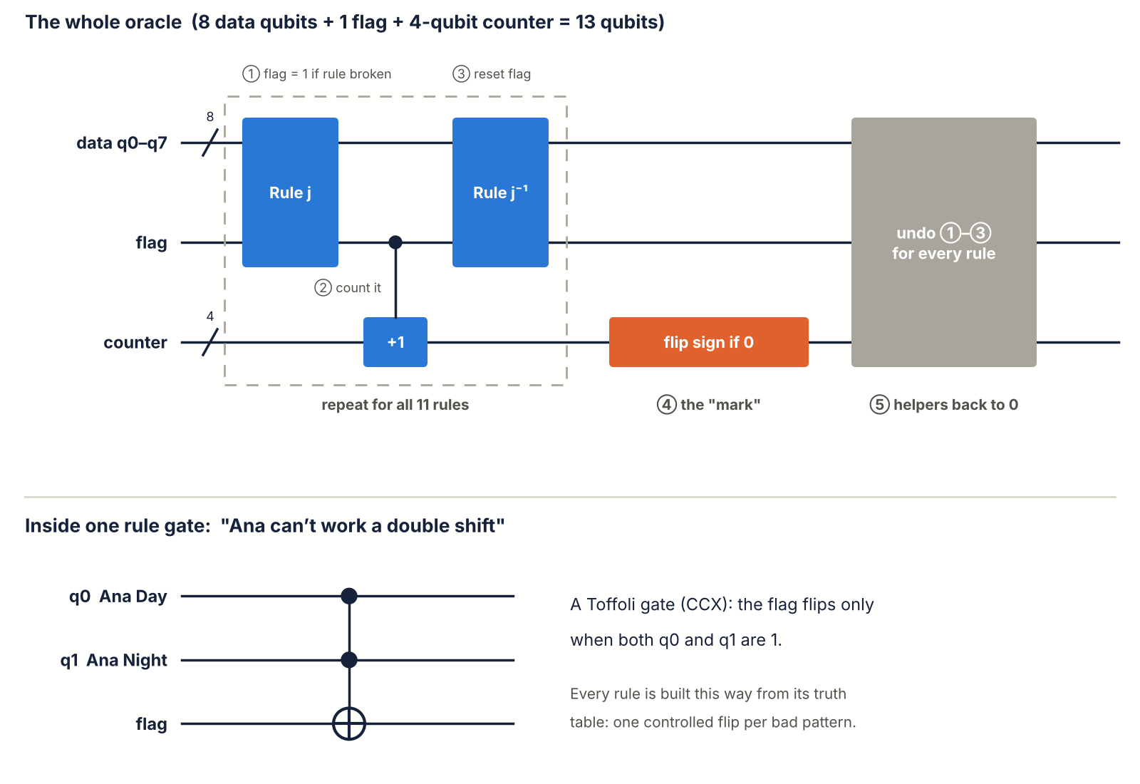
The oracle: count broken rules and flip if zero
for rule in problem.rules:
compute.append(gate, args) # flag = broken?
add_flag_to(counter) # counter += flag
compute.append(gate.inverse(), args)
qc.x(counter)
phase_all_ones(qc, counter) # sign flip if 0
qc.x(counter)
qc.compose(compute.inverse()) # clean up
Notes:
Each rule becomes a gate (built from its truth table) that sets a flag qubit when the rule is broken. A small counter adds up the flags; the phase flip happens only when the counter reads zero. Then everything is undone so the helper qubits return to zero. add_flag_to is shorthand for the controlled-increment lines in the real code.

Slide 12
The Grover loop
qc.h(data) # 1 superposition
for _ in range(iterations):
qc.compose(oracle.circuit) # 2 flip valid
qc.h(data); qc.x(data) # 3 diffuser:
phase_all_ones(qc, data) # reflect about
qc.x(data); qc.h(data) # the average
qc.measure_all() # 4 measure
Valid schedules
3θ
Invalid
oracle flip
known_iterations(8, 3) # → 7
Notes:
Circuit diagram: qc.draw('mpl') on the 4-qubit instance with 1 iteration is the most readable. known_iterations picks k nearest (π/4)·√(N/M) − 1/2.

Slide 13
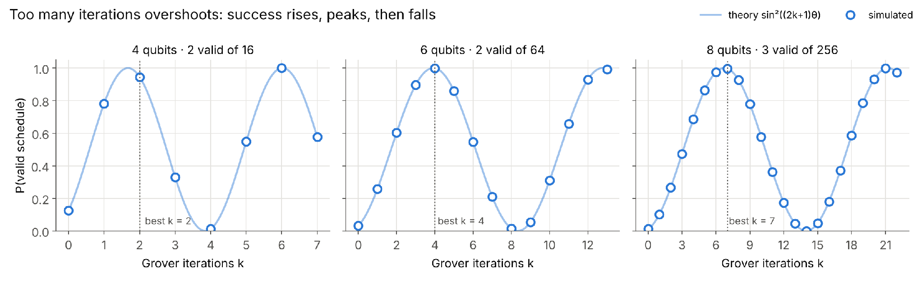
In a noiseless system, Grover works
Measured over 2,000 shots: 94.5%, 99.95% and 99.7% success, versus 12.5%, 3.1% and 1.2% for a random guess
Notes:
Discuss the fact that we don’t know how many solutions there are, leads to overshooting

Slide 14
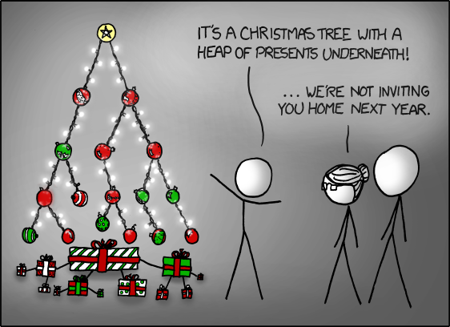
The classical opponents
def search(i, partial):
if not all(rule_still_possible(r, partial)
for r in problem.rules):
return None # prune
if i == problem.n:
return partial # valid schedule
for value in (0, 1): ... # try both
# plus brute force and Google OR-Tools CP-SAT
https://xkcd.com/835/
Notes:
All three classical methods use exactly the same rules as the quantum oracle, so the comparison is fair.

Slide 15
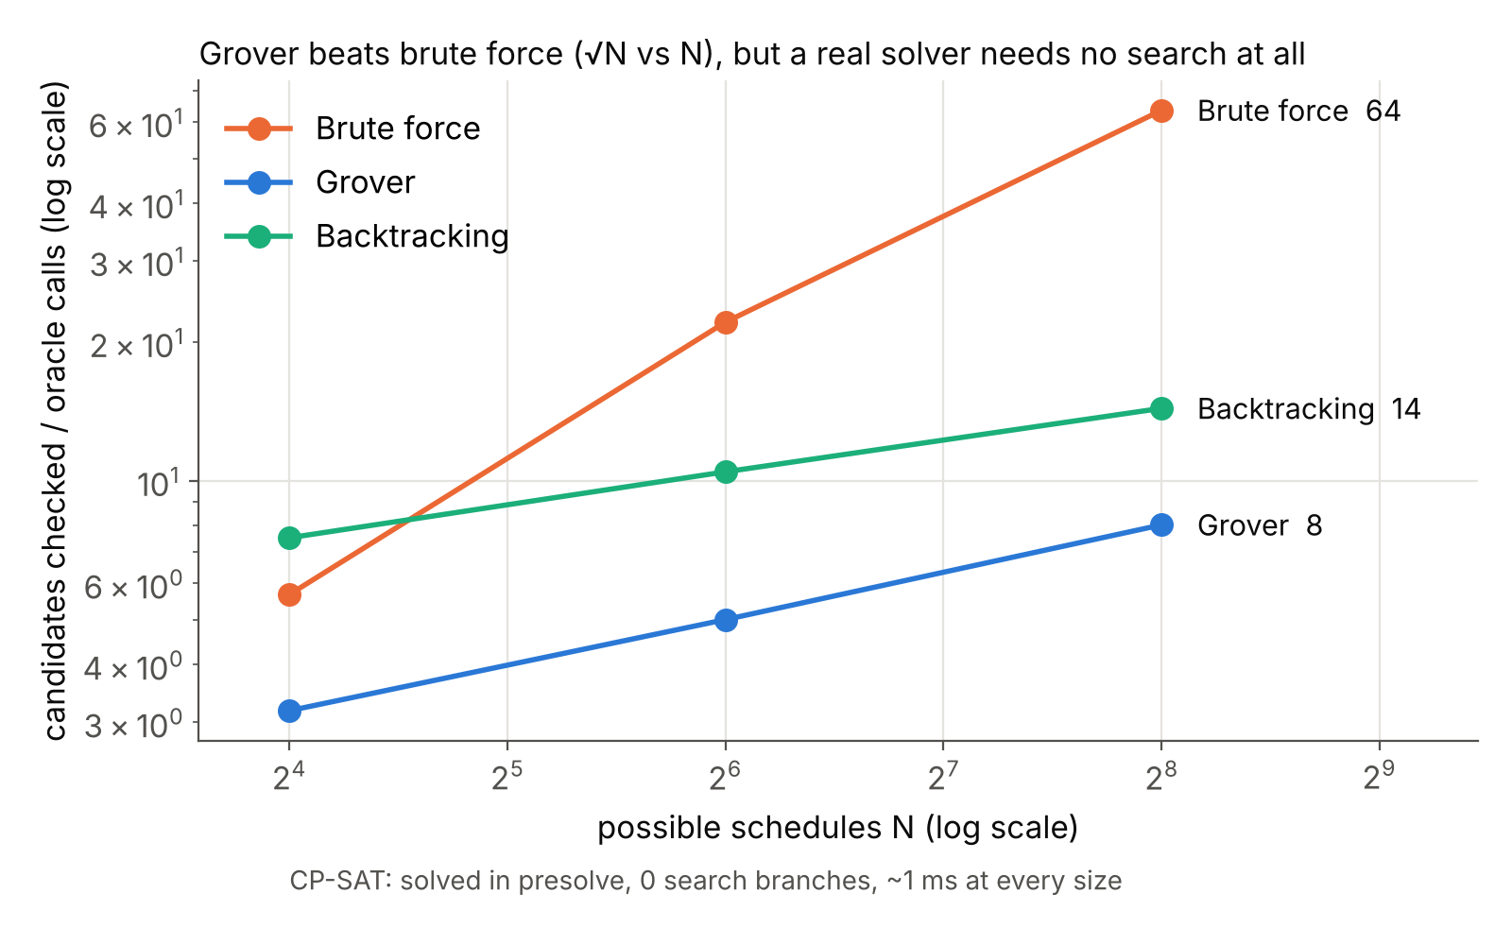
Fewer checks than brute force
Checks to find a valid schedule (8 qubits, 256 options)
Brute force | 64
Backtracking | 14
Grover | 8
CP-SAT | 0 (≈1 ms)
But a “check” isn’t the same size for each method…
Notes:
Units differ: Grover counts oracle calls plus output checks, backtracking counts partial schedules visited, CP-SAT counts search branches. CP-SAT’s presolve solved every instance without branching. Transition: here’s why the promise doesn’t hold up.

Slide 16
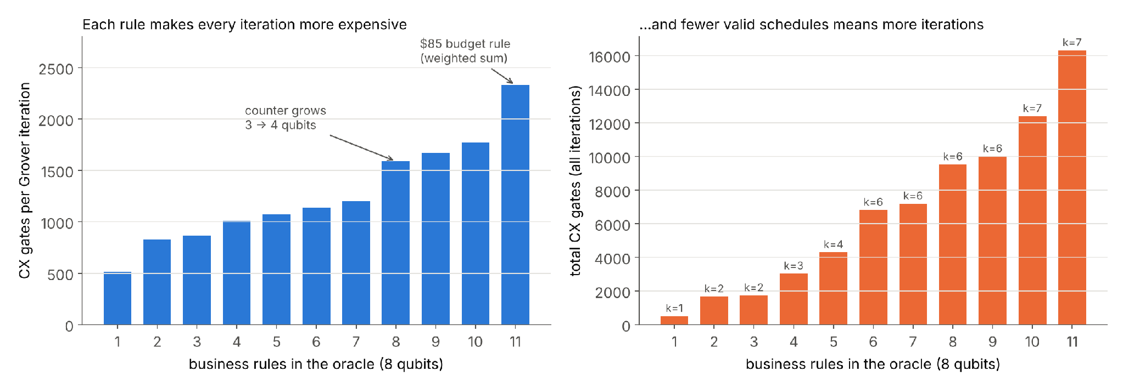
Reason 1: each quantum check is huge
One Grover check ≈ 2,300 two-qubit gates · 11 rules: 16,537 gates in total, before any error correction
Notes:
Two effects stack: each rule adds gates to every iteration, and tighter rules leave fewer valid schedules, which needs more iterations. The jump at rule 8 is the counter growing from 3 to 4 qubits; the budget rule alone adds about 560 gates. A classical check is a handful of instructions.

Slide 17
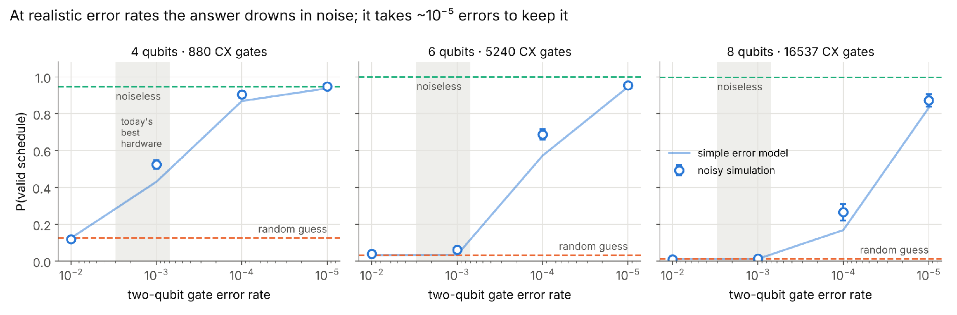
Reason 2: noise on hardware drowns the answer
8 qubits at 1-in-1,000 errors: 1.2% success, the same as guessing. It takes about 1-in-100,000 errors to reach 87%
Notes:
Depolarizing noise model on every gate (rate p on two-qubit gates, p/10 on single-qubit gates). The shaded band for today’s best hardware is approximate. The simple model line assumes any error scrambles the output.

Slide 18
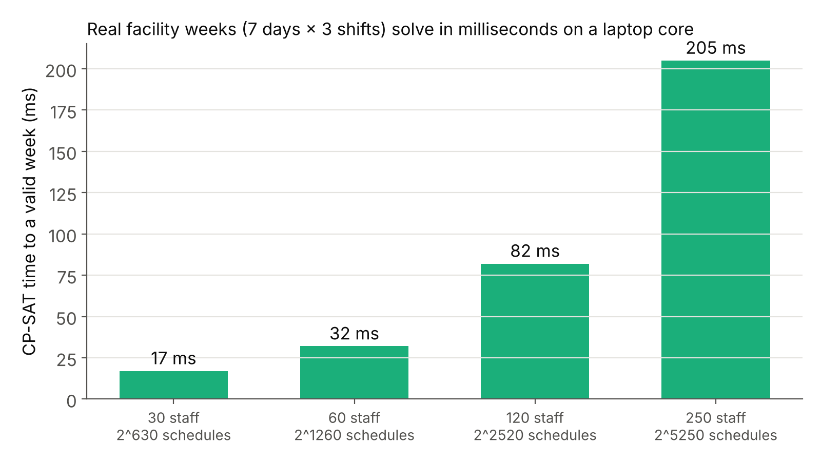
Reason 3: classical already wins at real size
17 ms
30 staff × 7 days × 3 shifts: 630 decisions, 2⁶³⁰ possible schedules
Grover would need 630+ qubits and about 2³¹⁵ iterations
Notes:
Real-size rules include coverage, nurse on every shift, no doubles, rest after nights, max 5 shifts per week, availability and personnel conflicts. One CPU core. The 2^315 figure is a rough estimate for a single valid schedule; with many valid schedules it’s smaller but still astronomically large.

Slide 19
Pass.
Grover’s speedup is real but small, today’s hardware drowns it in noise, and classical solvers already handle real schedules in milliseconds.
Notes:
Revisit quantum only if error-corrected hardware arrives. Hype vs. reality, for Q&A: “every schedule at once” — measuring returns one; “dramatically faster” — quadratic, and each check costs thousands of gates; “beats today’s software” — CP-SAT solves real weeks in milliseconds; “get in early” — at today’s error rates our run did no better than guessing.

Slide 20
Questions?
Insert Quantum Pun Here
Joseph Davis
Andrew Nicholls
Case Watkins
Calum Sommer

